Slide 1
The NASA FireSense Project
Michael Falkowski, Barry Lefer, Haris Riris, Michael Seablom, Teresa Kauffman, Melissa Martin, Emily Sylak-Glassman
NASA Headquarters

Slide 2
The NASA Science Mission Directorate (SMD) FireSense project is a 5-year effort focused on delivering NASA’s unique Earth science and technological capabilities to operational agencies, striving towards measurable improvement in US wildland fire management. The NASA SMD FireSense project is part of a larger NASA wide Wildland Fire Initiative involving SMD, the Aeronautics Research Mission Directorate (ARMD), and the Space Technology Mission Directorate (STMD).
The FireSense project will include an airborne science component (annual campaigns) where improved capabilities and technologies will be developed and evaluated, and ultimately demonstrated to agency stakeholders in a large capstone airborne campaign in year 5 of the project (2027-2028).
Through initial stakeholder engagement activities, the FireSense project will begin by focusing on four uses-cases focused on characterization and measurement of (i) pre-fire fuels conditions, (ii) active fire dynamics, (iii) post fire impacts and threats, and (iv) air quality impacts and forecasting, each co-developed with identified stakeholders.

Slide 3
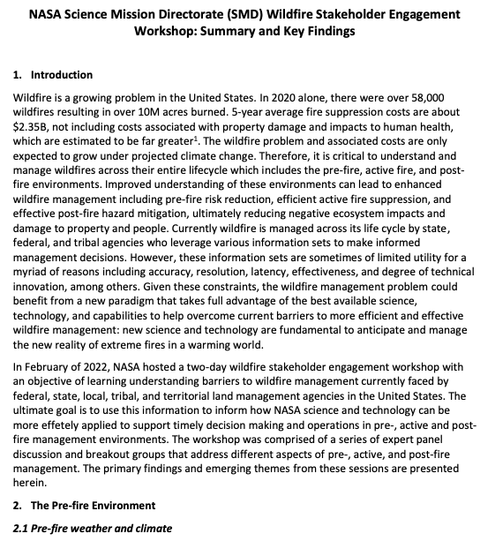
NASA FireSense is driven by Stakeholder Needs
Workshop Outcomes: Primary deliverable - whitepaper describing current barriers faced by agencies responsible for managing fire across its life cycle (pre-, active-, and post-fire).
Some of What we heard*:
Pre-fire –
Current fuels map of limited utility for operational management (increase accurate updates)
Fire behavior models do not have the necessary fidelity and/or timeliness to accurately predict fire behavior and fire spread
Current observations and forecasts of winds, humidity, and fuel moisture are insufficient for fire risk assessment and prediction
Active Fire –
Must reduce of time from ignition to detection and response
Need persistent (24/7) IR imagery of active fires to support fire management and monitoring (and fire science)
Lack of Reliable, high-speed communications/data
Need instruments capable of mass/power limitations of new suborbital platforms
Post-fire –
Improved mapping of forest burn extent and fire severity
Understand impacts to air and water quality and human health
Reduce debris flow prediction uncertainty: landslides, floods, impacts to watersheds
https://aam-cms.marqui.tech/aam-portal-cms/assets/ki2yd52vavkccskc

Slide 4
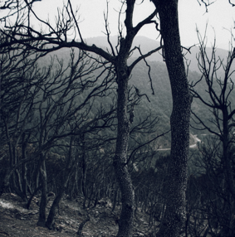
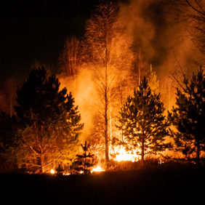
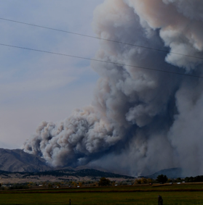
FireSense Use Cases
Pre-fire: Improved fire prevention by providing fire fuel maps with higher accuracy and resolution.
Provision of near real-time fire risks assessments based on fuel conditions, soil moisture, surface temperature, etc.
Stakeholders: USFS and USGS
Post-Fire: Improved maps of burn severity to aid in post-fire ecosystem rehabilitation efforts.
Predictions of post fire hazards and impacts including debris flow and landslide risks and water quality impacts.
Stakeholders: USFS and USGS
Active Fire: Better detection and tracking of fire via satellite and airborne imagery with higher spatial resolution and update frequency
Development of new, innovative sensors and models for precisely tracking and locating fires, fuels conditions, and smoke.
Stakeholders: USFS, CalFire, FEMA
Air Quality: Enhanced tracking and characterization of smoke plumes and smoke transport.
Improved forecasts of air quality impacts to human health and safety.
Stakeholders: NOAA and EPA

Slide 5
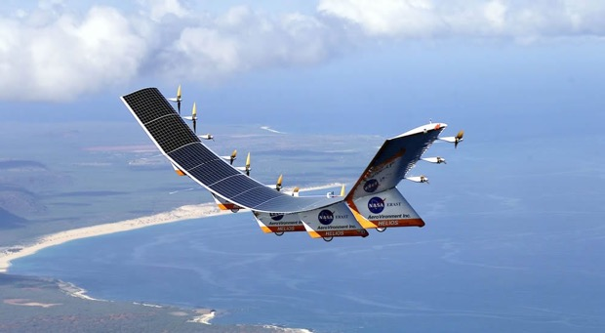
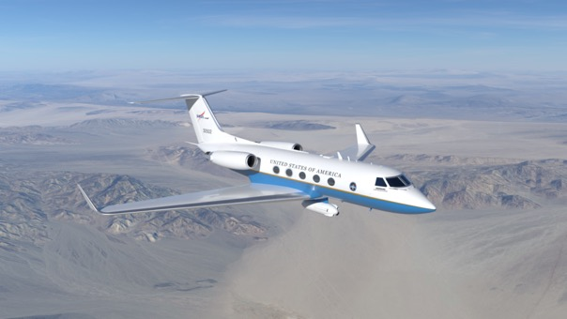
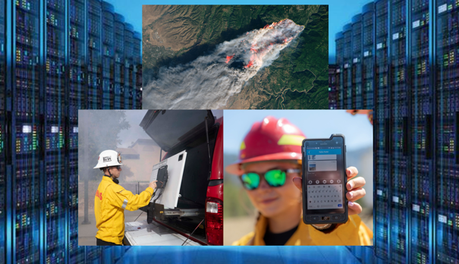
FireSense Implementation
Technology Development
Airborne Demonstration
Information Delivery
Enhance existing instruments used for monitoring pre-fire, active-fire, and post-fire environments
Develop next-generation aerial platforms as well as instruments for small spacecraft and aerial platforms for wildland fire applications
Enable measurements from multiple vantage points through model-directed, coordinated observations
Address computational challenges for modeling and for data acquisition, fusion, and real-time processing
Facilitate artificial intelligence to create new data products needed for wildfire management and for management of of observing platform constellations
Test existing and enhanced instruments used for monitoring pre-fire, active-fire, and post-fire environments
Evaluate existing and novel aerial platforms and next-generation instruments for wildland fire applications
Leverage airborne data to support research and application development in the for FireSense use cases
Demonstrate to key stakeholders the utility of existing and newly developed technology in the management of wildland fire across the pre-fire, active-fire, and post-fire environments
Work with stakeholders to develop wildland fire data systems and solutions that are flexible and aligned with desired capabilities
Ensure existing and new datasets (static and real-time) can be integrated into existing user-friendly web platforms (e.g., USFS WildfireSAFE, FIRMS, etc.)
Work with NASA ARMD and commercial and agency stakeholders to bridge the current communication gap in wildland fire management
Enable the seamless exchange of information between spaceborne, airborne, and in situ assets

Slide 6
FireSense Team
ESD FireSense Program (HQ)
Lead:
Michael Falkowski
Airborne Campaigns:
Melissa Martin and Barry Lefer, Research & Analysis
Modeling and Information Systems:
Michael Falkowski, Research & Analysis
Stakeholder Engagement and Capacity Building:
Emily Sylak-Glassman, Applied Sciences
Technology Development and Demonstrations:
Haris Riris and Teresa Kauffman, Earth Science Technology
ESD FireSense Project
Project Manager (ARC): Vacant
Announcement Link: https://www.usajobs.gov/GetJob/ViewDetails/720317600
Project Scientist (ARC): Selection Announcement forthcoming
Systems Engineer (JPL): Justin Boland
FireSense Implementation Team Lead:Vacant
FireSense Science and Applications team lead and membership to be competed
FireSense Partners
NASA Partner Organizations:
ARMD and STMD
External Partner Organizations:
EPA, NOAA, USFS, USGS, EDF, CalFire, Many Others

Slide 7
Thank You
Please contact Michael Falkowski for further information:
michael.falkowski@nasa.gov

